Slide 1
Deaf and Hard of Hearing: perspectives

Slide 2
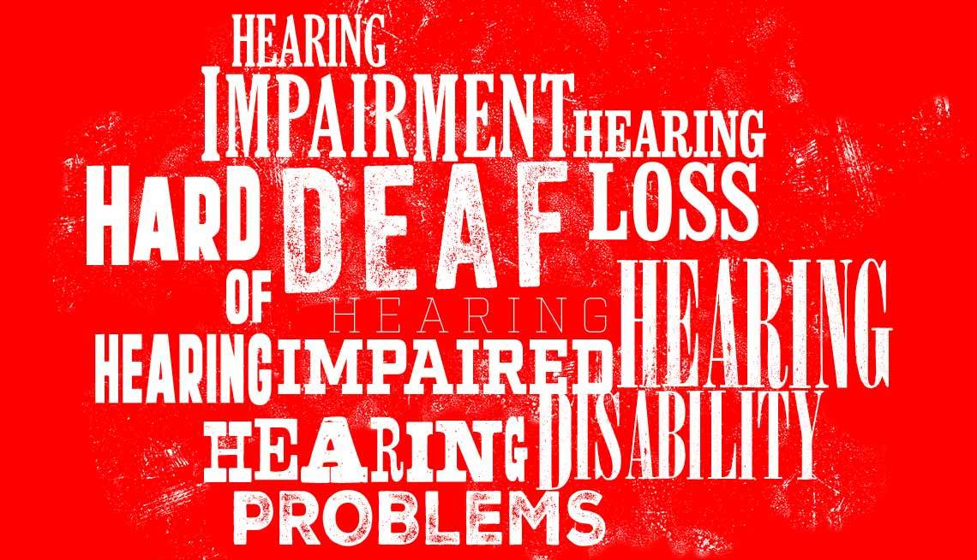
Deafhood or Deafness

Slide 3
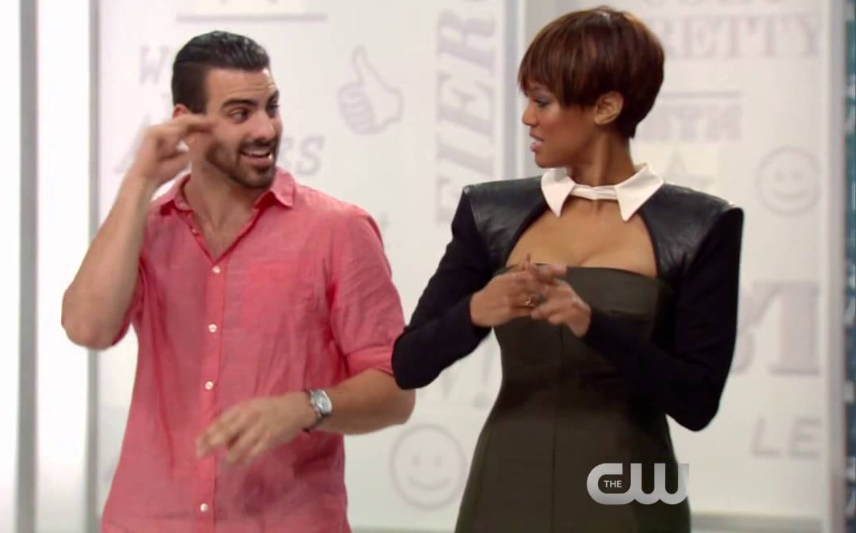
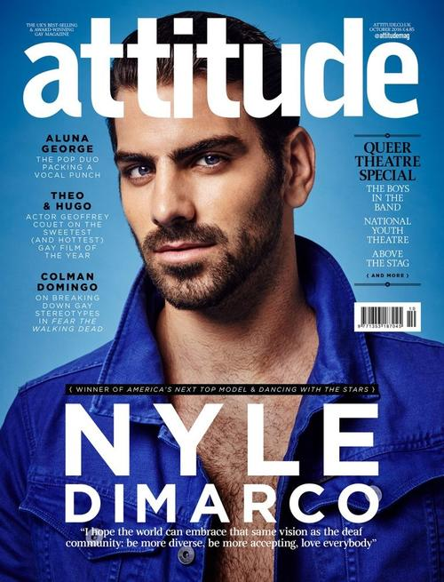
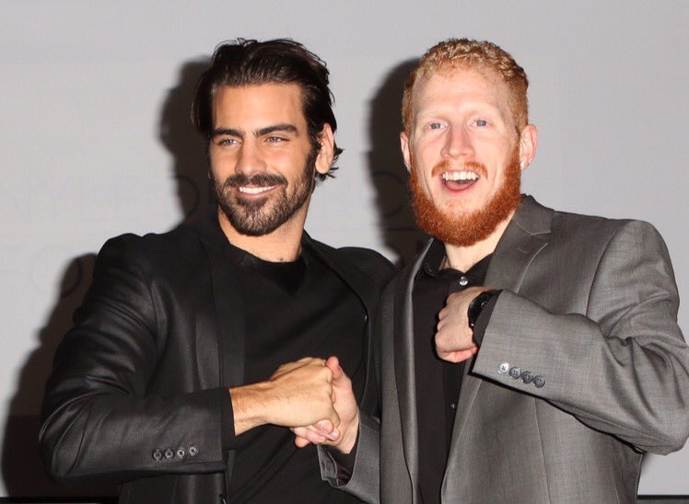
Nyle DiMarco
My Deaf Family Video
Dancing With the Stars Video

Slide 4
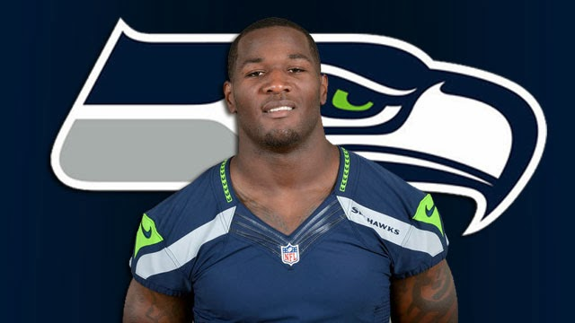
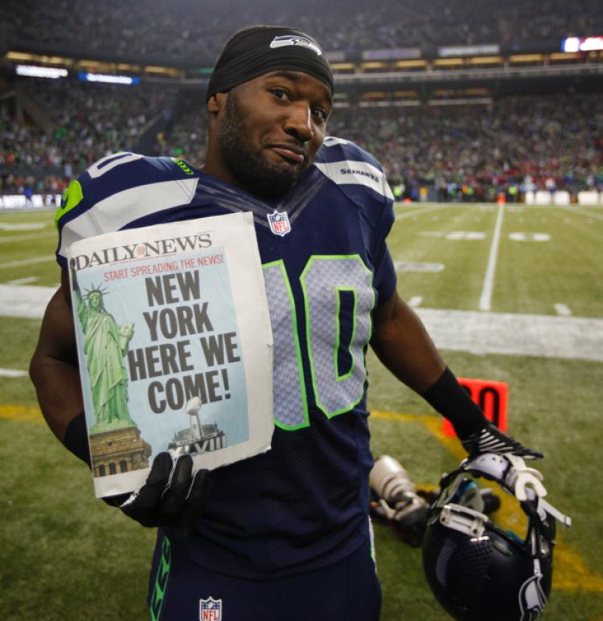
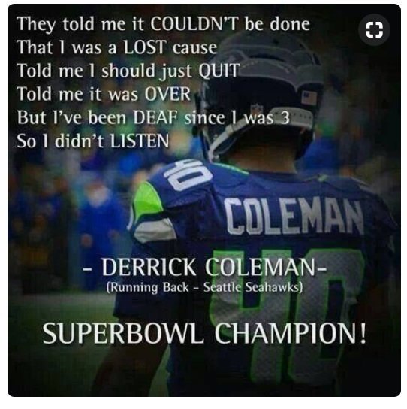
Derrick Coleman
Duracell Video

Slide 5
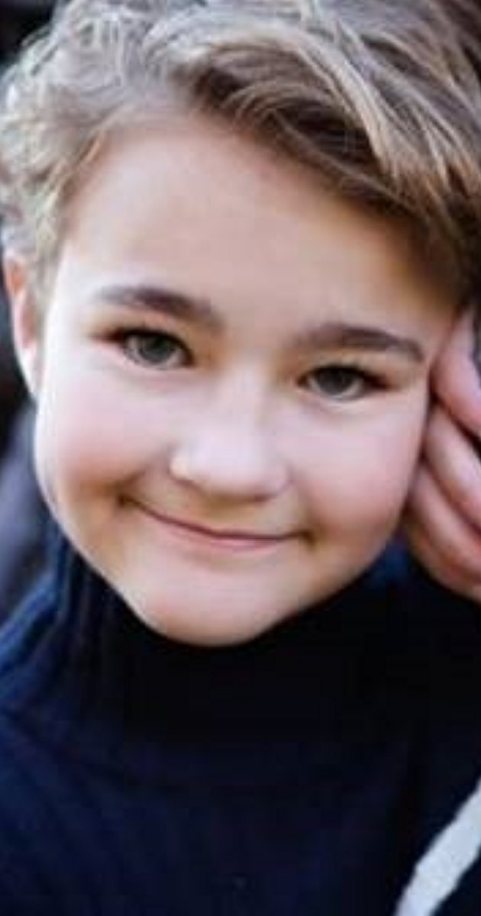
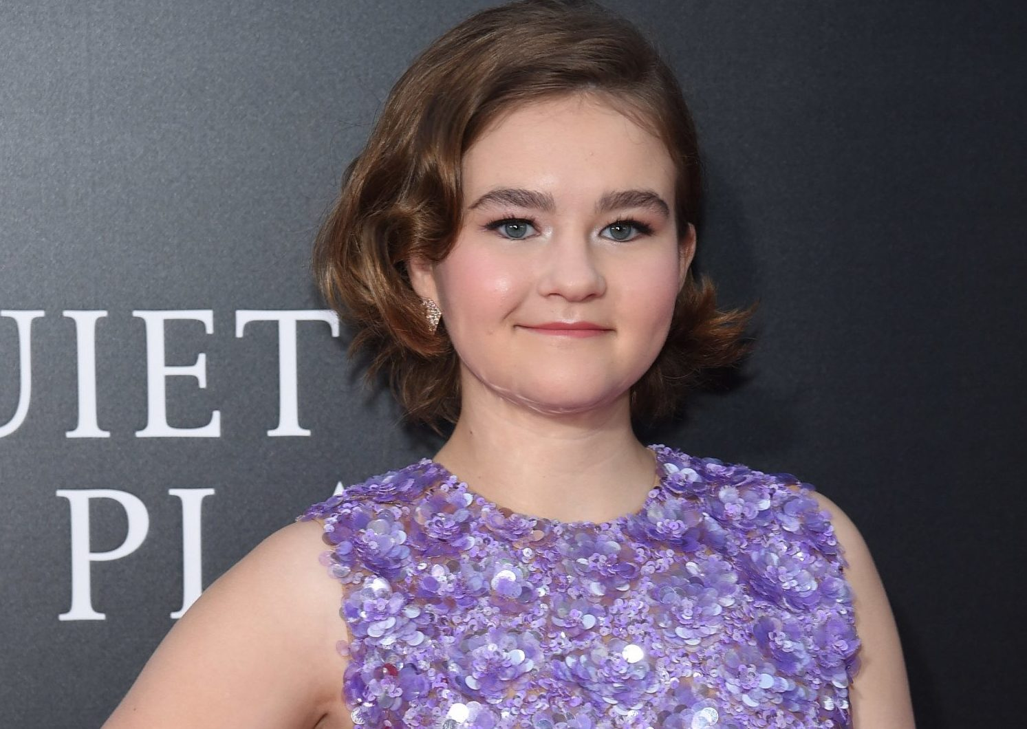
Millicent Simmonds
Quiet Place Interview Video

Slide 6
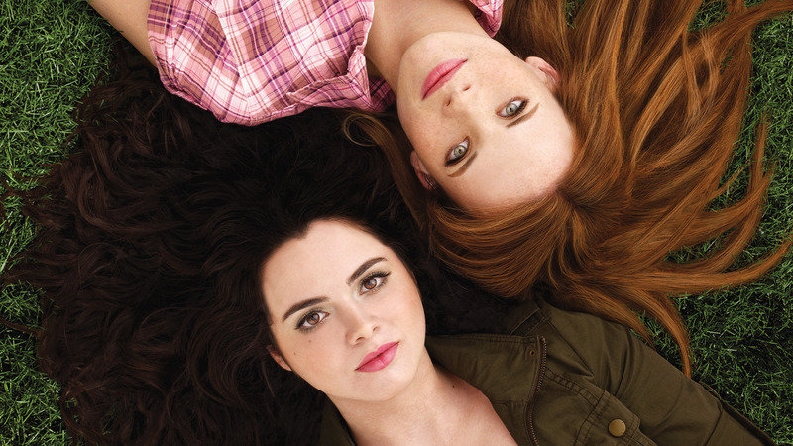

Katie LeClerc
Purple Video
SAB Video

Slide 7

Deaf Music Videos
We are gonna be friends Video

Slide 8
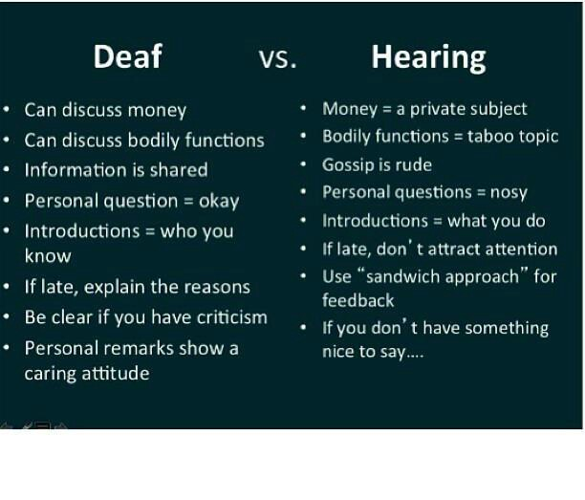
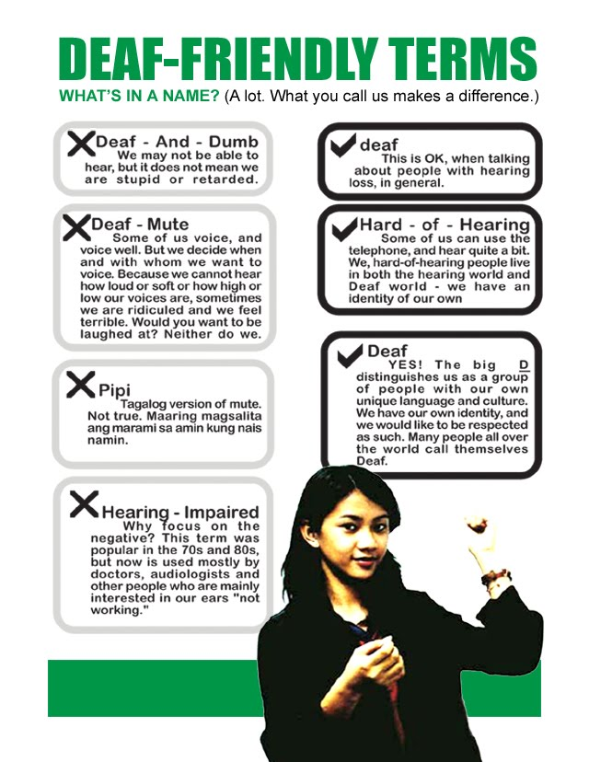
Deaf culture vs Hearing culture

Slide 9
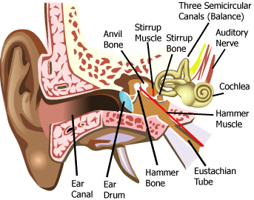
So, how does D/deafness happen?

Slide 10
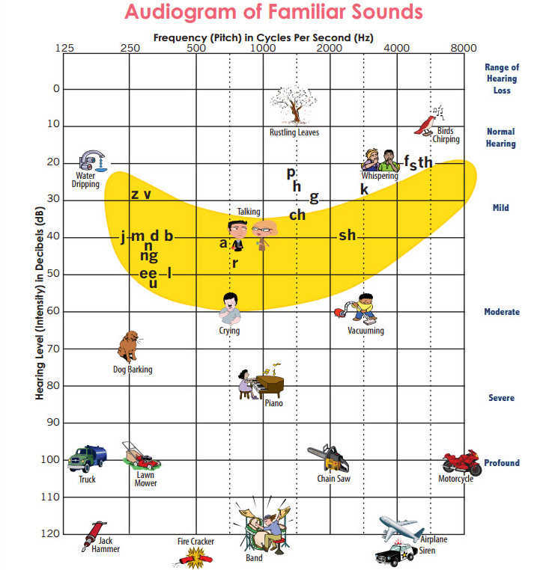
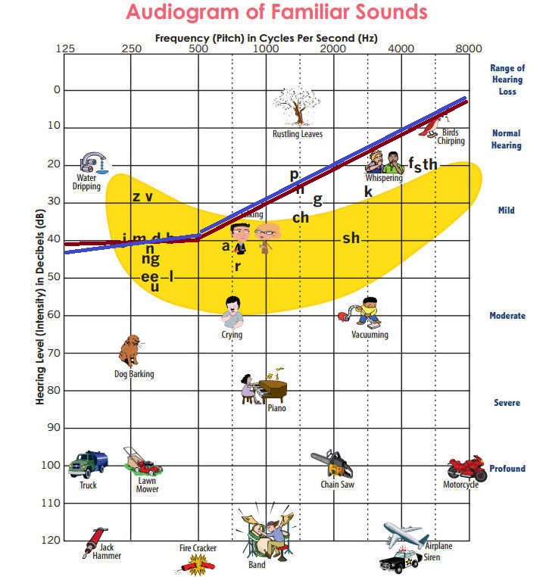
What does Deafness look like?

Slide 11
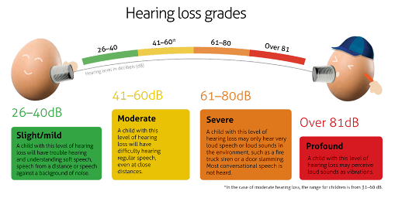
What does Deafness sound like?
Levels of Hearing Loss Video
Bad Lipreading Video

Slide 12
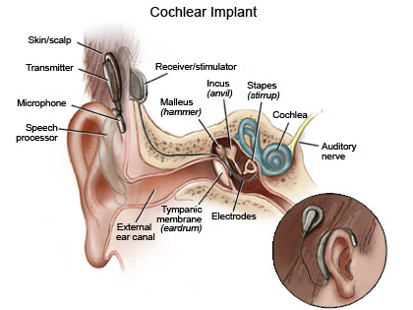

What options are there?
Cochlear Implant sounds like Video

Slide 13
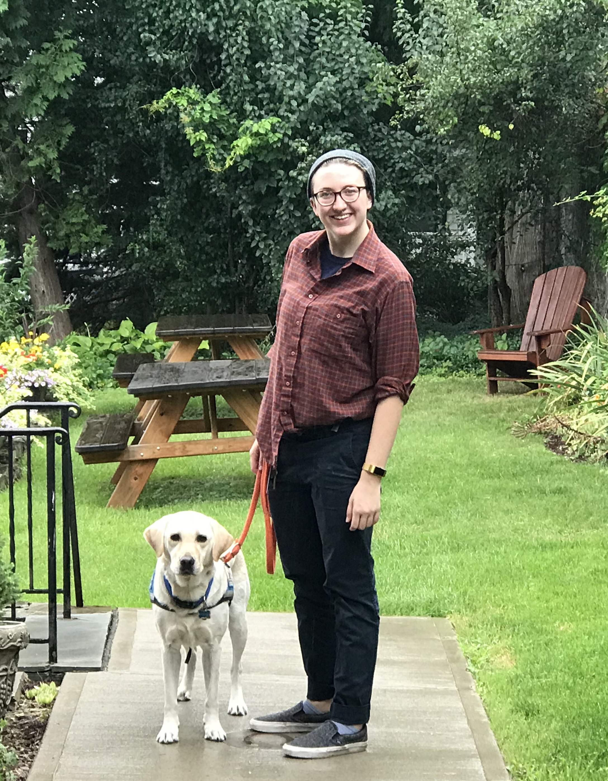

Hearing Dogs?
Leah
Coleman
Hearing Dog video

